Slide 1


Kubernetes Basics

Slide 2
Node Architecture

Slide 3
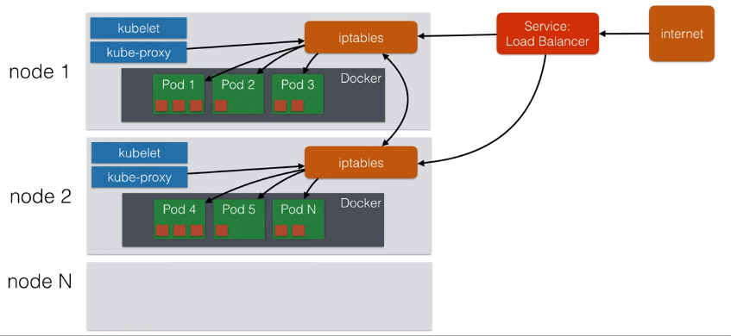
Architecture overview
Kubernetes should really be able to run anywhere
But, there are more integration for certain cloud providers, like AWS & GCE
Things like Volumes and External Load Balancers work only with supported Cloud Providers
I will first use minikube to quickly spin up a local single machine with a Kubernetes cluster
I’ll then show you how to spin up a multi-node cluster
Later : AWS using Kops***

Slide 4
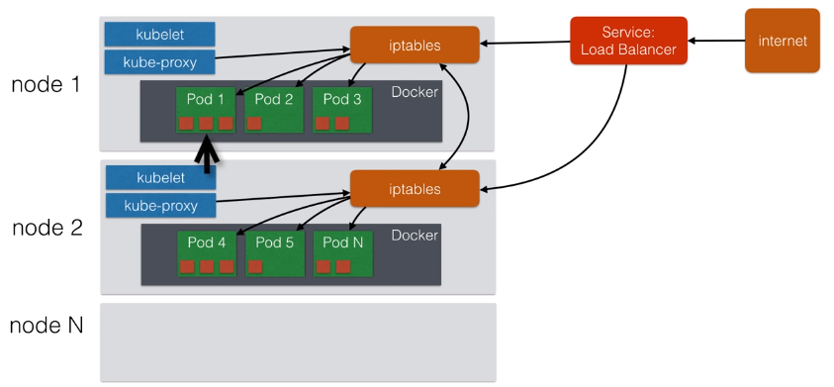
Architecture overview

Slide 5
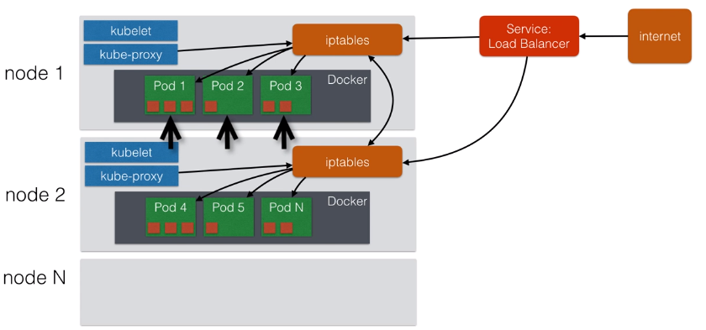
Architecture overview

Slide 6
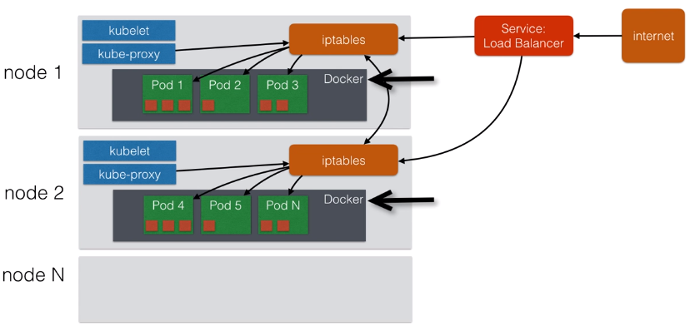
Architecture overview

Slide 7
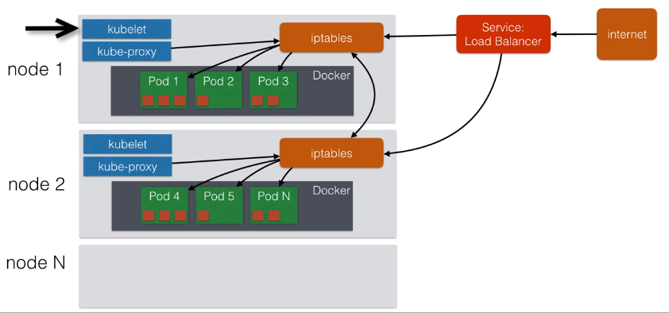
Architecture overview

Slide 8

Architecture overview

Slide 9
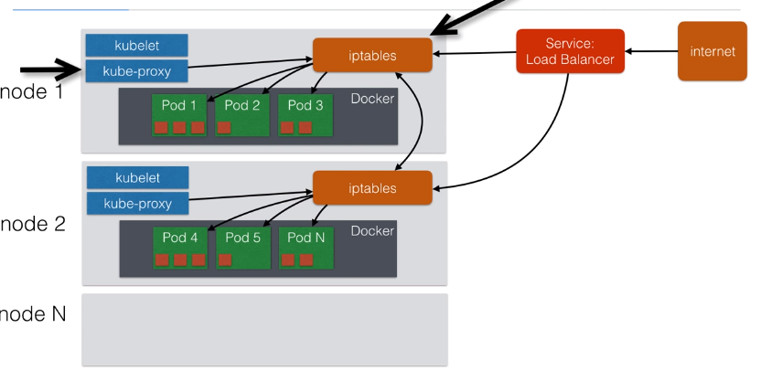
Architecture overview

Slide 10
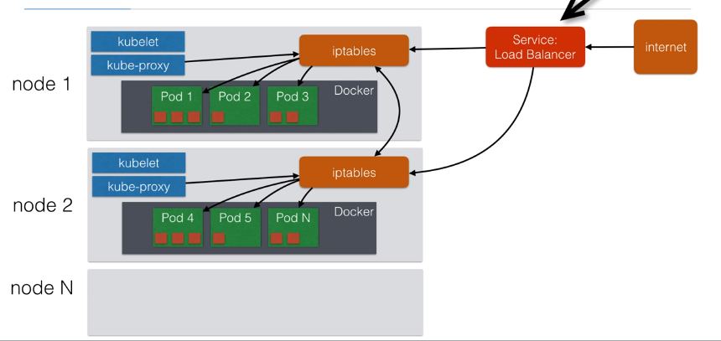
Architecture overview

Slide 11
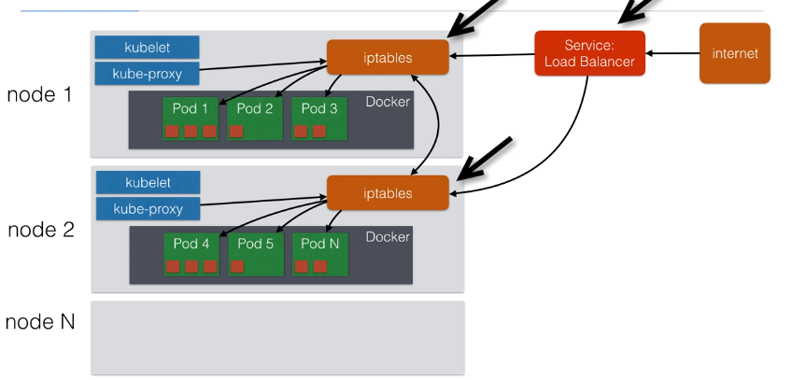
Architecture overview

Slide 12
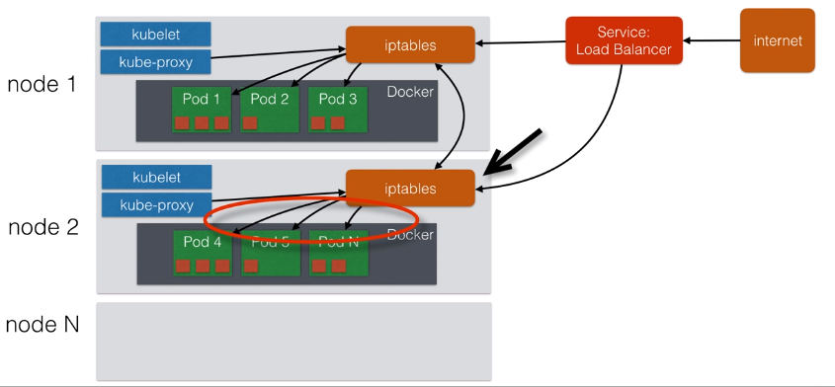
Architecture overview

Slide 13
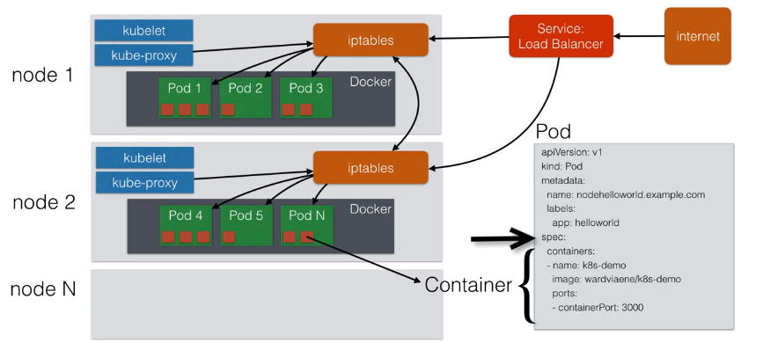
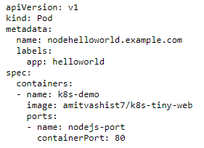
Architecture overview

Slide 14
Scaling pods

Slide 15
Scaling
If your application is stateless you can horizontally scale it
Stateless = your applicate doesn't have a state, it doesn't write any local file / keeps local session.
All traditional database ( MySQL, Postgres) are stateful, they have database files that can't be split over multiple session.
Most Web Application can be made stateless:
Session Management needs to be done outside the container ( MemCache, Redis etc)
Any files that need to be saved can't be saved locally on the container

Slide 16
Scaling
Our example app is stateless, if the same app would run multiple times, it doesn't change state.
Later in this course I'll explain how to use volumes to still run stateful apps
Those stateful apps can't horizontally scale, but you can run them in single container & vertically scale ( allocate more CPU/ Memory/ Disk )

Slide 17
Scaling
Scaling in Kubernetes can be done using the Replication Controller
The Replication Controller will ensure a specified number of pod replicas will run at all times
A Pods created with Replication Controller will automatically be replaced if they fail, get deleted, or are terminated.
Using the Replication Controller is also recommended if you just want to make sure 1 pod is always running, even after reboot.
You can then run a replication controller with just 1 replica
This makes sure that the pod is always running.

Slide 18
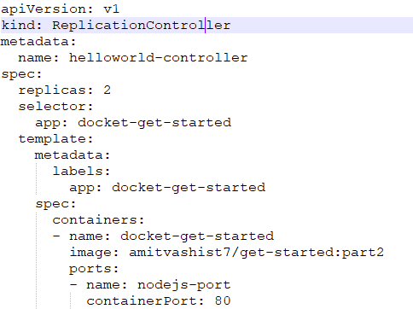
Scaling
To Replicate our example app 2 times

Slide 19
Demo Placeholder
Horizontally scale a pod with replication controller

Slide 20
Deployments

Slide 21
Replica Set
Replica set is the next-get Replication Controller
It support a new selector that can do the selection based on filtering according a set of values
Example: Environnent Ethier "Dev" or "QA«
not only based on equality, like replication controller
e.g "Environment" == "Dev“
This Replica Set, rather than the replication controller, is used by the Deployment Object

Slide 22
Deployment
A Deployment declaration in Kubernetes allows you to do app deployments and updates
When using the deployment object, you define the state of your application
Kubernetes will then make sure the cluster matches your desired state
Just using the replication-controller or replication set might be cumbersome to deploy apps
The Deployment Object is easier to use and gives you more possibilities

Slide 23
Deployment
With a deployment object you can:
Create a deployment ( e.g. deploying an app )
Update a deployment ( e.g. deploying an new version )
Do rolling updates ( Zero downtime deployment)
Roll Back to previous version
Pause/Resume a deployment ( e.g. to roll-out to only certain percentage )

Slide 24
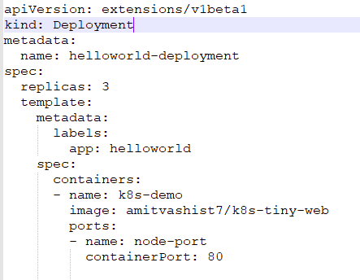
Deployment
This is an example of a deployment

Slide 25
Useful Commands
Command | Description
kubectl get deployment | Get info on current deployments
kubectl get rs | Get info about the replica sets
kubectl get pods --show-labels | Get info about the labels attached to those pods
kubectl rollout status deployment/helloworld-deployment | Get deployment status
kubectl set image deployment/helloworld-deployment k8s-demo=k8s-demo:2 | Run k8s-demo with image label version
kubectl edit deployment/helloworld-deployment | Edit the deployment Object
kubectl rollout history deployment/helloworld-deployment | Get the rollout history
kubectl rollout undo deployment/helloworld-deployment | Rollback to pervious version
kubectl rollout undo deployment/helloworld-deployment --to-revision=n | Rollback to any pervious version

Slide 26
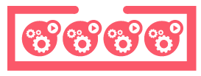


Rolling Updates
Service
app: my-app
ReplicationController
replicas: 3
selector:
app: my-app
version: v1
Live-update an application
$ kubectl rolling-update \
my-app-v1 my-app-v2 \
--image=image:v2

Slide 27
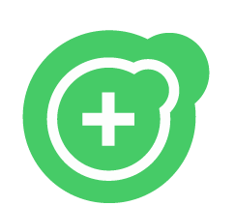
Rolling Updates
Service
app: my-app
ReplicationController
replicas: 3
selector:
app: my-app
version: v1
ReplicationController
replicas: 0
selector:
app: my-app
version: v2

Slide 28
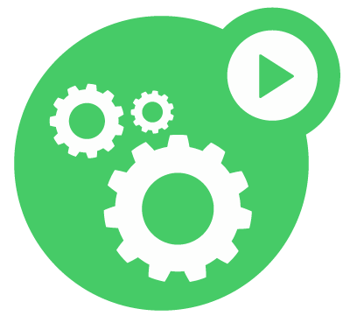
Rolling Updates
Service
app: my-app
ReplicationController
replicas: 3
selector:
app: my-app
version: v1
ReplicationController
replicas: 1
selector:
app: my-app
version: v2

Slide 29
Rolling Updates
Service
app: my-app
ReplicationController
replicas: 2
selector:
app: my-app
version: v1
ReplicationController
replicas: 1
selector:
app: my-app
version: v2

Slide 30
Rolling Updates
Service
app: my-app
ReplicationController
replicas: 2
selector:
app: my-app
version: v1
ReplicationController
replicas: 2
selector:
app: my-app
version: v2

Slide 31
Rolling Updates
Service
app: my-app
ReplicationController
replicas: 1
selector:
app: my-app
version: v1
ReplicationController
replicas: 2
selector:
app: my-app
version: v2

Slide 32
Rolling Updates
Service
app: my-app
ReplicationController
replicas: 1
selector:
app: my-app
version: v1
ReplicationController
replicas: 3
selector:
app: my-app
version: v2

Slide 33
Rolling Updates
Service
app: my-app
ReplicationController
replicas: 0
selector:
app: my-app
version: v1
ReplicationController
replicas: 3
selector:
app: my-app
version: v2

Slide 34
Demo Placeholder
A deployment

Slide 35
Services

Slide 36
Services
Pods are very dynamic, they come and go on the kubernetes cluster
When using a replication-controller, pods are terminated and created during scaling operations
When using Deployments, when updating the image version, pods are terminated and new pods take the place of older pods
That's why pods should never be accessed directly, but always through a Service
A Service is logical bridge between the "mortal" pods and other services or end-users

Slide 37
Services
When using the "kubectl expose" command earlier, you created a new service for your pod, so it could be accessed externally
Create a service will create an endpoints for your pod(s)
A ClusterIP: a virtual IP address only reachable from within the cluster. ( this is default )
A Nodeport: a port that is the same on each node that is also reachable externally
A LoadBalancer: a LoadBalancer created by the cloud provider that will route the external traffic to every node on the NodePort ( ELB on AWS )

Slide 38
Services
The option just shown only allow you to create virtual IPs or Ports
There is also a possibilities to use DNS Name
ExternalName can provide a DNS name for the service
e.g for service discovery using DNS
This only works when the DNS add-on is enabled
I will discuses this later in a separate lecture

Slide 39
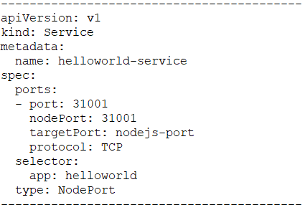
Services
This is an example of a Service definition ( also created using kubectl expose):
Note: By default service can run only between port 30000 - 32767, but you could change this behavior by adding the --service-node-port-range= argument to the kube-apiserver ( in the init scripts )

Slide 40
Demo Placeholder
A new service

Slide 41
Labels

Slide 42
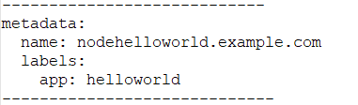
Labels
Labels are key/values pairs that can be attached to objects
Labels are like tags in AWS or other cloud providers, used to tag resources
You can label your objects, for instance your pod, following an org. structure
Key: environments - Value: Dev\ UAT\ QA\ PROD
Key: department - Value: R&D\ finance \ marketing
In our previous examples, I already have been using labels to tag pods

Slide 43
Labels
Labels are not unique & multiple labels can be added to one object
Once labels are attached to an object, you can use filters to narrow down results
This is called Label Selector
Using Label Selector, you can use matching expressions to match labels
For instance, a particular pod can only run on a node labeled with "environment" equal "Dev".
More complex matching: "environment" in "Dev" or "QA".

Slide 44
Node Labels
You can also use labels to tag nodes
Once nodes are tagged, you can use label selectors to let pods only run on specified nodes
There are 2 steps required to run a pod on specific set of nodes:
First you tag the node
Then you add a nodeSelector to your pod configuration

Slide 45
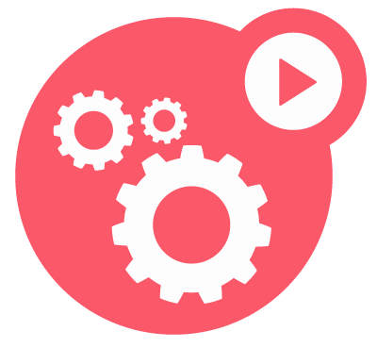
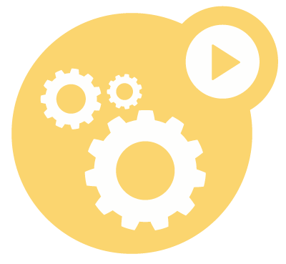
Labels
User-provided key-value attributes
Attached to any API object
Generally represent identity
Queryable by selectors
think SQL ‘select ... where ...’
The only grouping mechanism

Slide 46
Selectors
app: my-app
app: my-app
track: stable
track: stable
tier: FE
tier: BE
app: my-app
app: my-app
track: canary
track: canary
tier: FE
tier: BE

Slide 47
Selectors
app: my-app
app: my-app
track: stable
track: stable
tier: FE
tier: BE
app: my-app
app: my-app
track: canary
track: canary
tier: FE
tier: BE
app = my-app

Slide 48
Selectors
app: my-app
app: my-app
track: stable
track: stable
tier: FE
tier: BE
app: my-app
app: my-app
track: canary
track: canary
tier: FE
tier: BE
app = my-app, tier = FE

Slide 49
Selectors
app: my-app
app: my-app
track: stable
track: stable
tier: FE
tier: BE
app: my-app
app: my-app
track: canary
track: canary
tier: FE
tier: BE
app = my-app, tier = BE
Notes:
e.g., to push a configuration change

Slide 50
Selectors
app: my-app
app: my-app
track: stable
track: stable
tier: FE
tier: BE
app: my-app
app: my-app
track: canary
track: canary
tier: FE
tier: BE
app = my-app, track = stable

Slide 51
Selectors
app: my-app
app: my-app
track: stable
track: stable
tier: FE
tier: BE
app: my-app
app: my-app
track: canary
track: canary
tier: FE
tier: BE
app = my-app, track = canary
Notes:
e.g., to shut down canary

Slide 52

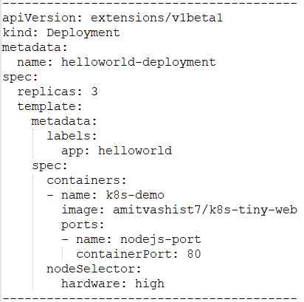
Node Labels
First Step, add a label or multiple labels to your nodes:
Secondly, add a pod that uses those labels:

Slide 53
Demo Placeholder
Node Selector using labels

Slide 54
Health Checks

Slide 55
Health Checks
If your application malfunctions, the pod & container can still be running, but the application might not work anymore.
To detect & resolve problems with your application, you can run health checks
You can run 2 different type of health
Running a command in the container periodically
Periodic checks on the a URL ( HTTP)
The Typical production application behind a load balancer should always have health checks implemented in some way to ensure availability & resiliency of the app.

Slide 56
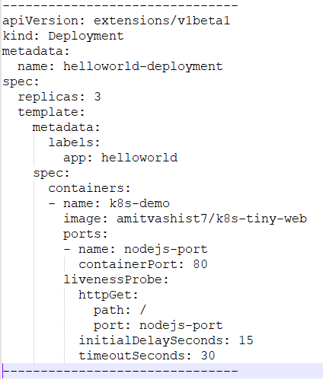
Health Checks
This is how a health check looks like on our example container:

Slide 57
Demo Placeholder
Performing health checks

Slide 58
Secrets

Slide 59
Secrets
Secrets provides a way in kubernetes to distribute credentials, Keys, passwords or "secret" data to the pods
Kubernetes itself uses this Secrets mechanism to provide the credentials to access the internal API
You can also use the same mechanism to provide secret to your application
Secrets is one way to provide secret, native to Kubernetes
There are still other ways your container can get the its secrets if you don't want to use Secrets ( e.g using an external vault services in your app)

Slide 60
Secrets
Secrets can be used in the following ways:
Use Secrets as environment variables
Use secrets as a file in a pod
This setup uses volumes to be mounted in a container
In this volume you have files
Can be used for instance for dotenv files or you app can just read this file

Slide 61
Secrets
To generate secrets using files:
A Secret can also be an SSH Key or an SSL certificate

Slide 62
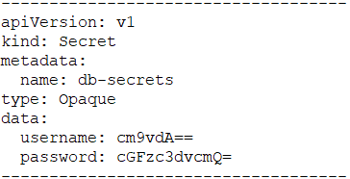


Secrets
To generate secret using yaml definitions:
secrets-db-secret.yml
After creating the yml file, you can use kubectl create:

Slide 63
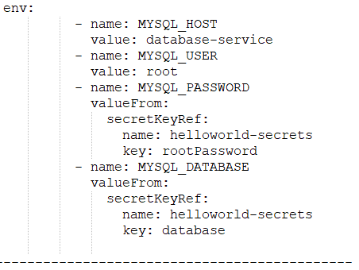
Using Secrets
You can create a pod that expose the secret as environment variables:

Slide 64
Demo Placeholder
Secrets
Setting up Wordpress

Slide 65
Thank You

